Slide 1
Notes:
The Innovation Festival brings together people from all over the world to share their skills and interests to solve problems and come up with new ideas. This year we would like children to add their skills into the mix and as part of the festival, help us solve some big problems that the whole world needs to consider
The UN Sustainable Development Goals were introduced in 2015, by the United Nations, to the world. To live in a healthy, peaceful and prosperous world the 17 Global Goals (SDG’s) need to be solved and we all need to know about them.

Slide 2
EXPLORE WITH NWG
THE GLOBAL GOALS
Notes:
Introducing the first Workshop in the series of 3.
The Global Goals is our starting point and something we think all children and young people should be aware of.

Slide 3
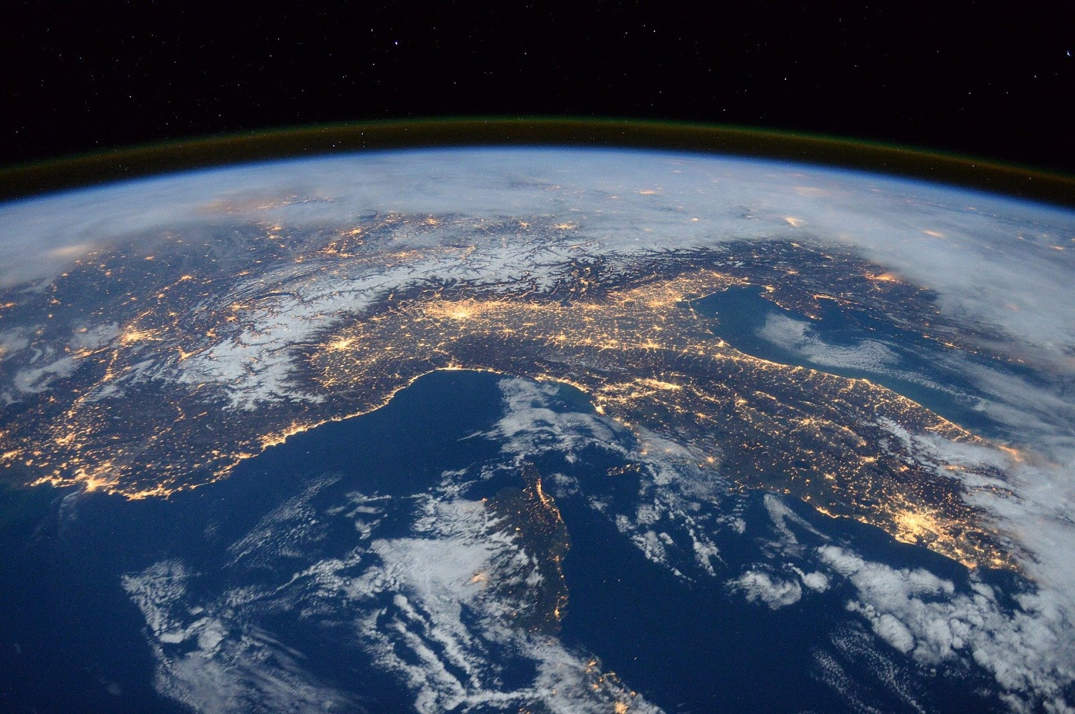
Notes:
Our world is a really big place and lots of people live on our planet (over 7 billion) as well as animals and sea creatures. We all need to live off the land and we all need access to food, water, clothes, oxygen and a place to call home.

Slide 4
Think about…
What are the main things we need access to?
Notes:
What else do you think we need access to? Think about when you feel poorly, where you are today, what powers your home etc.

Slide 5
Do you think…
all the people on our planet have the same rights and access?
Notes:
Do you think everyone all over the world has access to all of these things? Do you think we are luckier than others?

Slide 6
The World is not equal
We don’t all have access to the same basic things
We don’t all have the same rights
...and the more people that live on our planet, the less there is to go around.
Notes:
Do you think everyone all over the world has access to all of these things? Do you think we are luckier than others?

Slide 7
How does this make you feel?
Notes:
How does that make you feel? Does it worry you, concern you, make you angry or sad?
Teacher Tip: You could encourage learners to add their thought on to post it and explore. Push them on adjectives and why. We want to evoke emotion and create desire to make a change/difference.

Slide 8
What needs to happen?
Notes:
To create change we need a catalyst / a spark and a reaction, just like the one you have shown there….
Governments joined together in 2015 and came up with this….

Slide 9
Notes:
In 2015 the United Nations (this is when countries from all across the world get together to share and discuss how they can work together to make the world a better place), met and created a plan of what needs to happen to make the world better.
The UN gave themselves a deadline to see change happen - 2030. How old will you be then? What do you imagine yourself doing in 2030? Working, married, a millionaire, living on Mars?

Slide 10
What Goal do you think is most important and why?
Notes:
Discuss the Goals together - encourage pupils to think about which goal they think is most important and why?

Slide 11
How are we going to achieve the Goals?
Notes:
Encourage Learners to think about what needs to happen for the change to occur and for the Goals to be met by 2030….

Slide 12
To achieve the Global Goals we need to everyone to know what they are and care about solving them by doing the following:
- Invent: New idea or solution
- Innovate: Make something that exists, even better!
- Change-make: Think differently and encourage others too
Notes:
What do these words mean and and can you think of examples for each?

Slide 13
In the Future….
We need you to be the future:
Inventors
Innovators
Change-makers
… you are going help make this happen!
Notes:
To solve the problems the world is presented with, we need YOU all to have an enterprising nature, do what you are great at and think how you can contribute to and solve the SDGs, to make sure we sustain our planet and ensure world has equality.

Slide 14
Starting Today….
You are going to join us on our innovation journey, help us solve problems linked to our sector and… develop lots of skills along the way!
ACTIVITY TIME
Notes:
ACTIVITY: Can you think about ways your class / school could support the achievement of the Goals?
ACTIVITY: Encourage pupils to think about the skills needed to help solve the goals:
Problem solving
Science skills
Teamwork
Resilience
Maths
Engineering
Coding
Communication
Listening
Sharing ideas
Motivation
At the festival you will meet, and take part in activities that will help you explore the goals further AND develop lots of these skills further. We are really excited that you will be joining us and look forward to seeing you.
Until then, we will be sharing more resources with you so you can keep exploring….

Slide 15
What could you and your school do to raise awareness and help achieve the Goals?
Notes:
Learners could choose a goal to focus on or think about all of the goals… how could they become Global Ambassadors, share with their families and community?

Slide 16
See You Soon
Notes:
At the festival you will meet, and take part in activities that will help you explore the goals further AND develop lots of these skills further. We are really excited that you will be joining us and look forward to seeing you.
Until then, we will be sharing more resources with you so you can keep exploring….

